Slide 1


Bioimage Informatics Lecture 5, Spring 2014
Linear Systems View of an Optical Imaging System
Prahlad G Menon, PhD
Assistant Professor
Sun Yat-sen University – Carnegie Mellon University (SYSU-CMU)
Joint Institute of Engineering
Lecture 5 January 29, 2014
Notes:
Hello. I would like to start by welcoming you to this class on bioimage informatics. This graduate-level class is cross-listed as BME 42-731 & ECE 18-795.

Slide 2
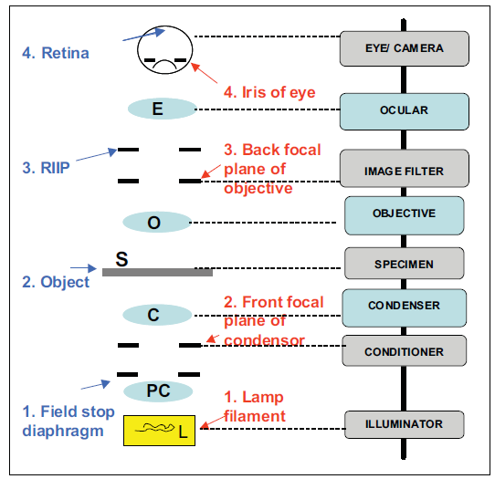
Basic Microscope Setup
How a Lens Works
Diffraction Pattern
Linear System's view of an optical system
From text: Microscopic Image Analysis for Life Science Applications

Slide 3
Performance Metrics of a Microscope
Resolution: the smallest distance that can be resolved.
Field of view: the area of a specimen that can be observed and recorded in an image.
Depth-of-field: the axial distance (depth) in the specimen that appears in focus in an image.
Light collection power: it determines image brightness.
Image bit depth: A 16 bit images have a finer discretization of the range of intensity data stored than an 8 bit image, at each pixel / voxel. Without recording ability the light collection power of a microscope (or telescope for that matter) cannot be taken advantage of…

Slide 4
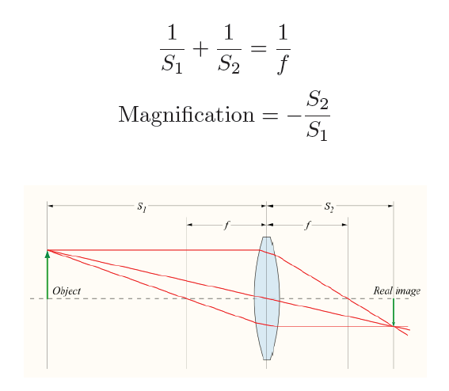
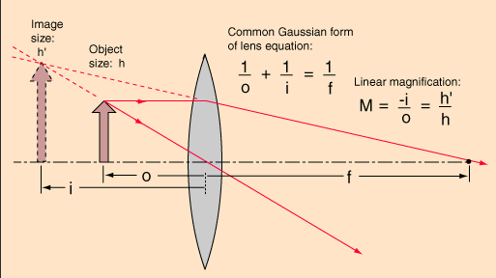
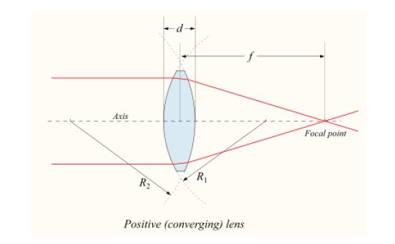
Optics: Some Basics (I)
Lens and Magnification (courtesy, Wikipedia)
Thin lens approximation (a simple math model)
Real v/s Imaginary Images
Magnifying Glass Optics

Slide 5
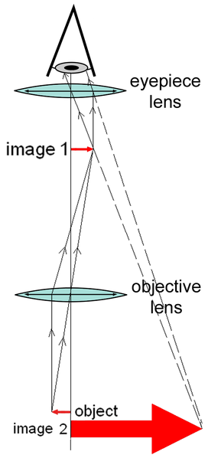
Lenses of the Compound Microscope
Gives the viewer an erect enlarged virtual image.
Oculars (eyepieces): provide some magnification, focus image at eye (can be 1 or 2 of them)
Objectives: located on rotating nosepiece, provide magnification and resolving power (may be 3 to 6 of them)
Condenser: located under stage, focuses light on the specimen. It may also contain an iris diaphragm that controls the size of the cone of light entering the condenser.

Slide 6

Magnification
The overall magnification is given as the product of the lenses and the distance over which the image is projected:
where:
D = projection (tube) length (usually = 250 mm);
M₁, M₂ = magnification of objective and ocular.
250 mm = minimum distance of distinct vision for 20/20 eyes.

Slide 7
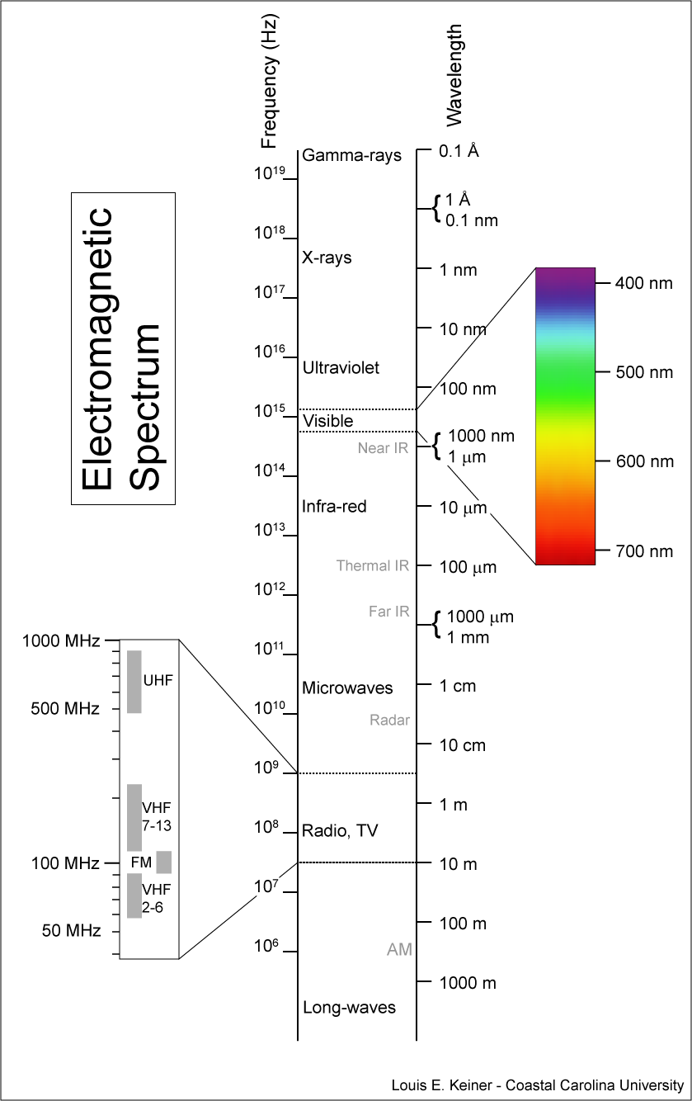
Photon Energy (II)
Energy of a photon: Planck's law
Shorter waves have higher energy.
h: Planck's constant; 6.626×10⁻³⁴J·s v: frequency of light; λ: wavelength of light
c: speed of light energy of a photon = 3.973 ×10⁻¹⁹J at 500nm

Slide 8

What is a Linear System..? Ax = b
Microscope Modeling – breaking optical imaging down to a science…
Linear transforms you probably know :
Rotation, translation, scaling – spatial transforms
Convolution
Wolfram – definition of a linear operator:

Slide 9
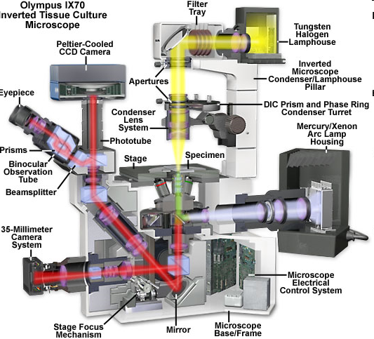
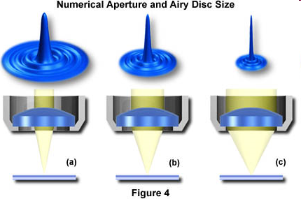
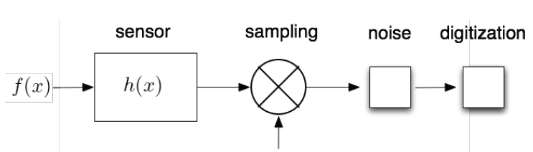
A Microscope can be modeled as a Linear System
Today’s
class
A light microscope can be considered as a linear system.
http://micro.magnet.fsu.edu/primer/java/imageformation/airydiskformation/index.html
sampling function (dirac delta)
MICROSCOPE
CAMERA (eg: CCD device)

Slide 10
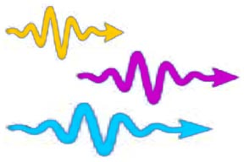
Recording the Image: what is actually happening at each Pixel?
Grey Scales
CCD
Electrons
Photons
System Gain
Quantum Efficiency,
Photon Counting Errors

Slide 11
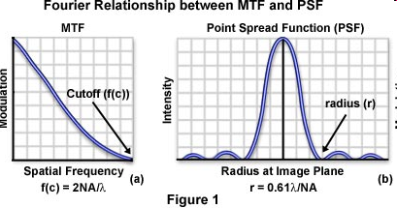
Microscope Image Formation
The impulse response of the microscope is called its point spread function (PSF).
The transfer function of a microscope is called its optical transfer function (OTF).
The PSF has the shape of an Airy Disk.

Slide 12
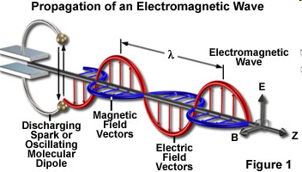
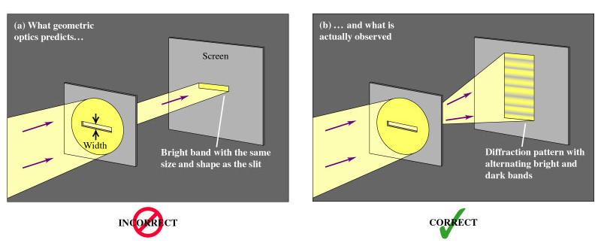
Optics: Some Basics (III)
Light has characteristics of both particle and wave (particle-wave duality).
A photon is a quantum of electromagnetic radiation and the unit particle of light.

Slide 13
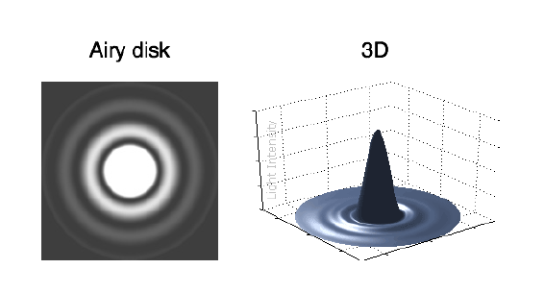
Diffraction Patterns – linear aperture
Lets do a derivation together ! Linear aperture: the single slit experiment.
Questions addressed:
What is a point spread function..?
How is it formed..?
How does it work on an
input signal ..?
Hint: Convolution.

Slide 14
Conclusions on Single Slit Diffraction
– when does light behave like a wave..?
The “geometrical” picture breaks down when slit width becomes comparable with wavelength .
Clearly, diffraction is relevant to microscopes with small apertures!

Slide 15
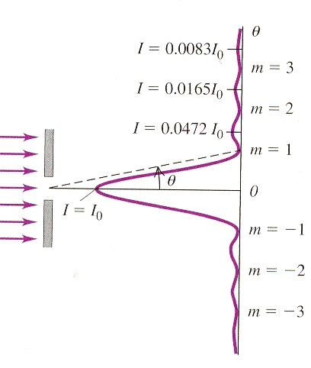
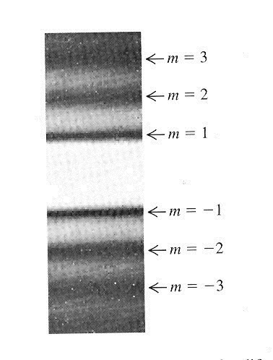
Sinc Function: Width of central maximum
We can define the width of the central maximum to be the distance between the m = +1 minimum and the m=-1 minimum, below.
This pattern is called a Point Spread Function (PSF).
It is modeled mathematically as the Sinc Function = (sinθ) / θ
http://mathworld.wolfram.com/SincFunction.html
Δy
image of diffraction pattern
Narrower the slit, the more the diffraction pattern “spreads out”
Intensity
distribution

Slide 16
What does this mean for the particle nature of light..?
Attempting to localizing photons in the y-direction to a slit of width a leads to a spread of y-momenta of at least h/a.
So, the more we seek to localize a photon (ie define its position) by shrinking the slit width, a, the more spread (uncertainty) we induce in its momentum:
In this case, we have Δp_{y}Δy ~ h

Slide 17
Microscope Image Formation
Microscope image formation can be modeled as a convolution with the PSF.
http://micro.magnet.fsu.edu/primer/java/mtf/airydisksize/index.html

Slide 18
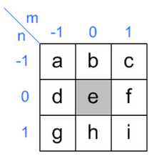
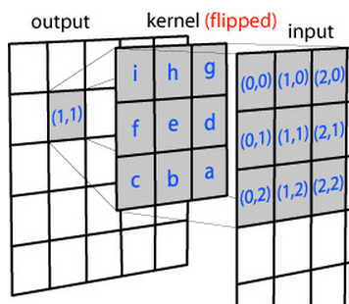
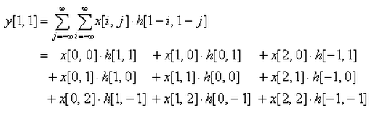
The Convolution Operator – what happens to an input 1D image function, f(x,y) as it passes through an aperture ..?
Simple example of convolution of input image (matrix, S) and impulse response (kernel) in 2D spatial. Y[n] = (S * h) [n].
Notice that the kernel matrix is flipped both horizontal and vertical direction before multiplying the overlapped input data.
Notes:
Common image processing operations become simpler in the fourier space. Read more here.
Blackboard work: Derive the sinc function and establish how it leads to what is known as the Airy Disc pattern. Single slit and Double slit experiments.

Slide 19
Circular Aperture - Airy Disk Diffraction Pattern
Airy (after George Biddell Airy) disk is the diffraction pattern of a point feature under a circular aperture.
It has the following form
Detailed derivation is given in Born & Wolf, Principles of Optics, 7th ed., pp. 439-441.
J₁(x) is a Bessel function of the first kind.

Slide 20
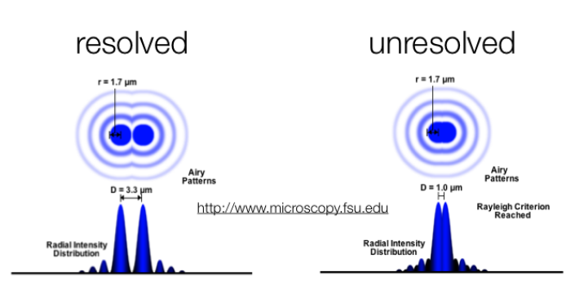
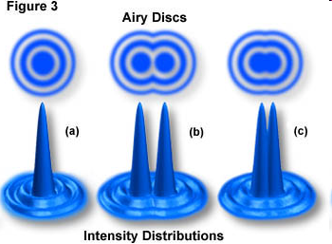
Different Definition of Light Microscopy Resolution Limit (Demo)
Rayleigh limit
Sparrow limit
http://www.microscopy.fsu.edu/primer/java/imageformation/rayleighdisks/index.html

Slide 21
Beyond the Rayleigh Limit… Is the Rayleigh limit (200 nm) unbeatable by an optical system..??
Some Perspective - a recap:
The resolution of far field instruments is fundamentally limited by the wave nature of light. A practical definition of the resolving power is the well known Rayleigh criterion.
It states that two points are just resolved if their lateral separation equals the radius of the first dark ring of the Airy pattern.
For green light (wavelength 540 nm) and objectives with a numerical aperture (NA) of 1.4, this criterion imposes a limit of 240 nm

Slide 22
Beyond the Rayleigh Limit… We’ve been beating the Rayleigh limit for a while now…
Fluorescence microscopy, a resolution beyond the common Rayleigh limit can be achieved by means of a nonuniform excitation pattern that contains high spatial frequency components.
In scanning confocal fluorescence microscopy (CFM), this pattern is a small light spot that is scanned over the specimen, theoretically yielding a 1.4-fold improved resolution compared with standard fluorescence microscopy.
True optical resolution beyond the Rayleigh limit achieved by standing wave illumination
7232–7236 | PNAS | June 20, 2000 | vol. 97 | no. 13
Jan T. Frohn, Helmut F. Knapp, and Andreas Stemmer*
This paper defines harmonic excitation light microscopy (HELM) to outperform the lateral resolving power of CFM by a factor of 1.5 and additionally avoid disadvantages of scanning methods.

Slide 23
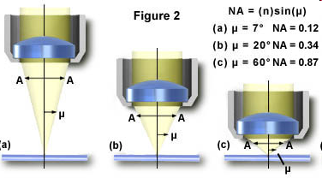
Numerical Aperture
Numerical aperture (NA) determines microscope resolution and light collection power.
n: refractive index of the medium between the lens and the specimen
μ: half of the angular aperture

Slide 24
Field of View (Demo)
Field of view: the region that is visible under a microscope
If characterized in diameter
If characterized in area
http://micro.magnet.fsu.edu/primer/java/microscopy/diaphragm/index.html

Slide 25
Depth-of-Field
Depth-of-field: the axial distance (depth) in the specimen that appears in focus in the image.
n: refractive index of the medium between the lens and the specimen
λ: emission wavelength
M: magnification
NA: numerical aperture
e: smallest resolvable distance in the image plane

Slide 26
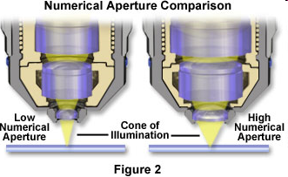
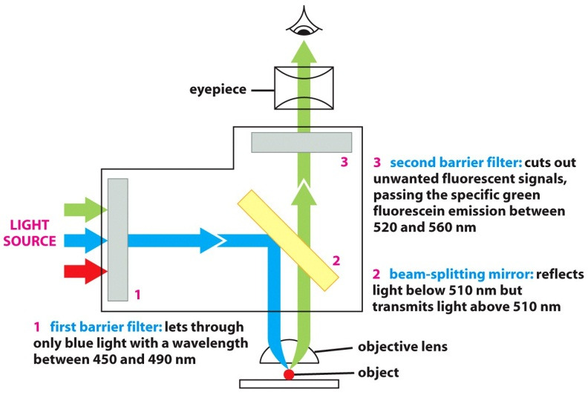
Image Intensity: Light Collecting Power
For transmitted and reflected light
For fluorescence

Slide 27
Working Distance
The distance between the objective lens and the specimen.
Working distance does not directly influence imaging but may determine how images can be collected.

Slide 28
Summary: High Resolution Microscopy
Size of cellular features are typically on the scale of a micron or smaller.
To resolve such features require
- Shorter wavelength (electron microscopy) - High numerical aperture (resolution) - High magnification (spatial sampling)
Resolution (D) improves (gets smaller) if λ ↓ or n↑ or α↑ (parameters affecting NA)

Slide 29
Summary: High Resolution Microscopy
Higher magnification and higher numerical aperture mean - Smaller field of view
- Smaller depth of field
- Lower light collection power
- Smaller working distance

Slide 30
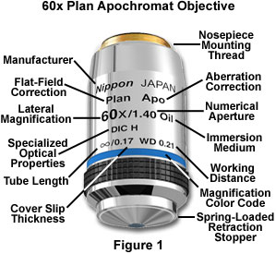

Objective Specifications
Why Oil immersion medium..? ☺

Slide 31
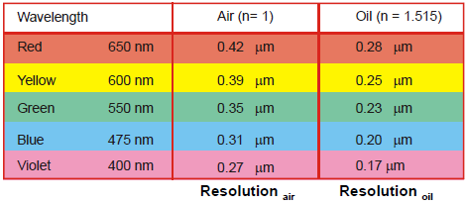
Checking your Math!
Assuming that sin α = 0.95 (α = 71.8°)
Maximum resolution by Rayleigh Limit:
d_{min} = 0.61 λ / N.A.
d_{min} is the minimum distance between objects that can be seen as distinct (in μm).
λ is the wavelength (for light, 380 -760 nm = 0.38 - 0.76 μm)
N.A. is the Numerical Aperture of the objective lens
N.A. = n sin α where n = index of refraction of medium, α = < subtended by the lens
Example: green light (λ = 0.52 μm):
d_{min} = (0.61)(0.52)/1.4 = 0.23 μm

Slide 32
Questions?

